Slide 1
Super Store
File created on: 10/15/25 1:49:01 PM MST

Slide 2
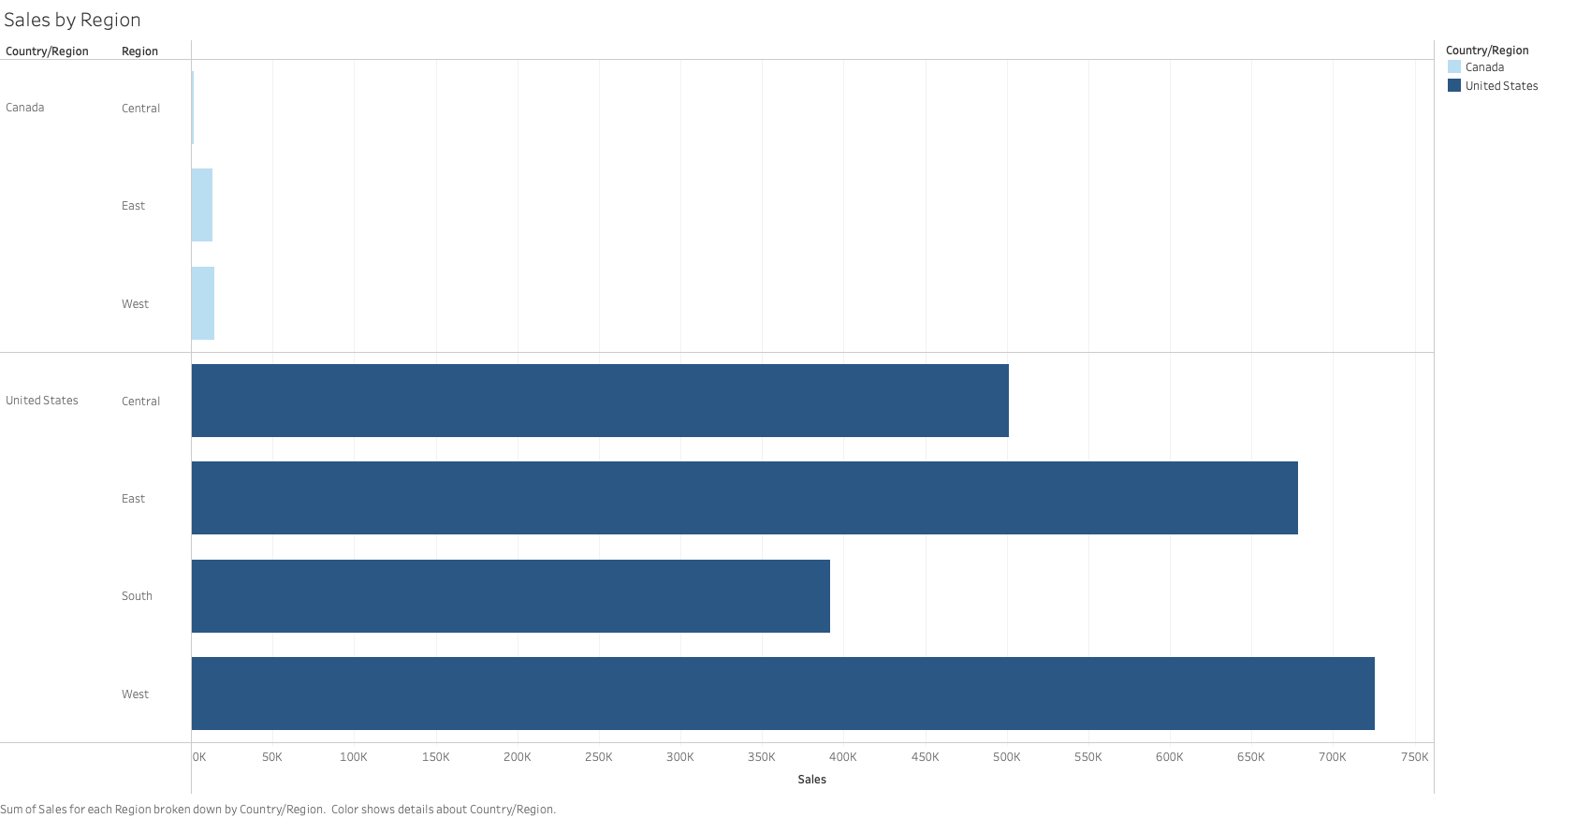

Slide 3
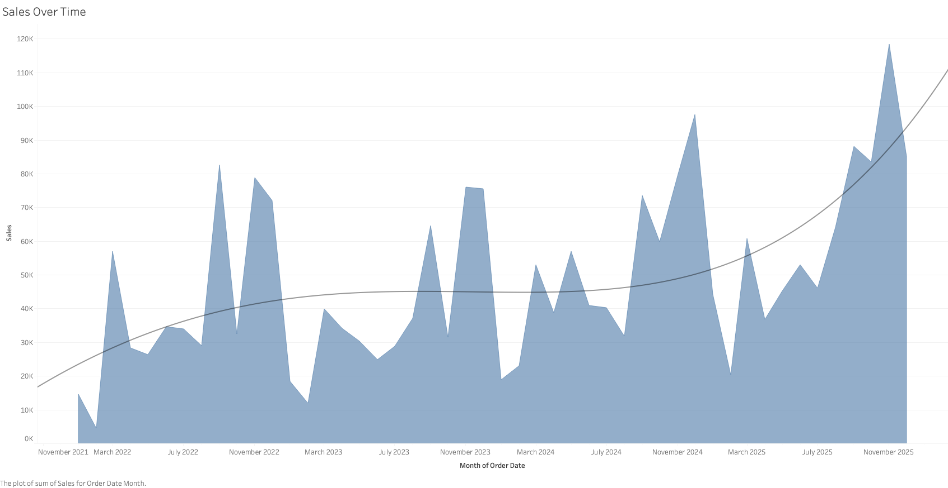

Slide 4
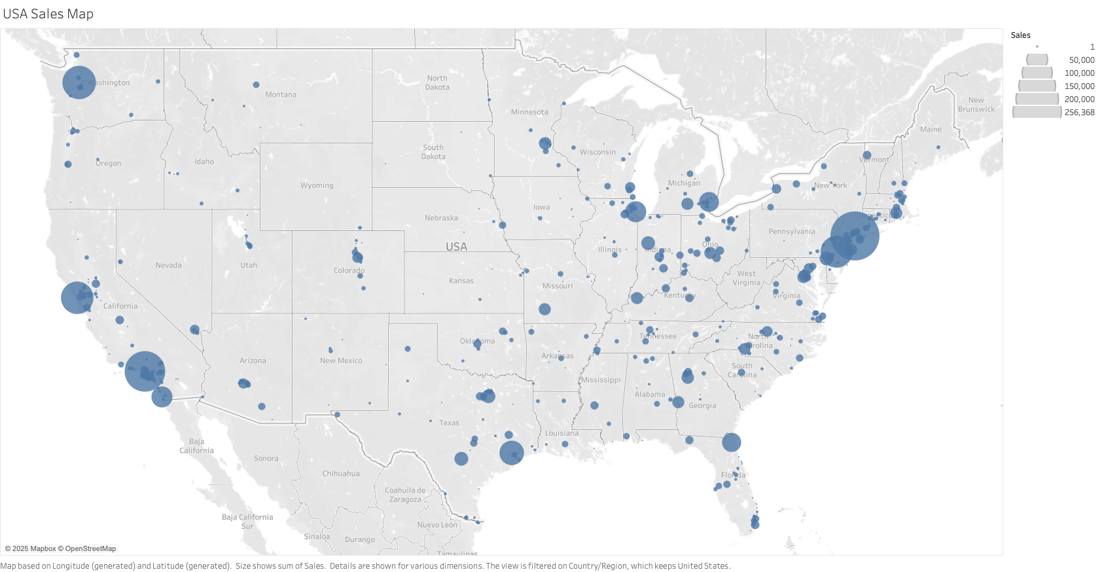

Slide 5
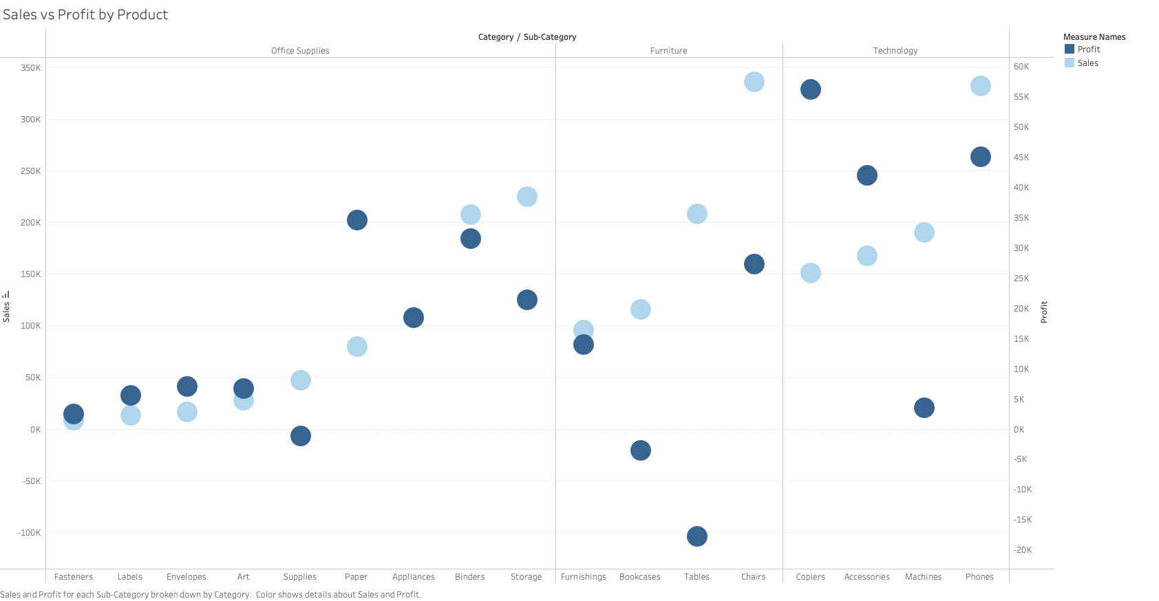

Slide 6
